Slide 1







Video Game Design
Hampton, Virginia 2024-2025
Team ID: 21648-2

Slide 2
Table of Contents
Title Page……………………………………………………………1 Table of Contents……………………………..……………………..2 Purpose and Description of Video……………….………………….3 Evaluation of video…………………………….……………………4 Storyboard........................................................................................5-6
Script/screen sheet……………………………………..…….…….7-8 Hardware/software used……………………………...………………9 References and Sources…………………………………………….10 Student Copyright Checklist……………………………….....….....11 Consent and Release Form………………………....………………12 Work Log………………………………………………......……….13

Slide 3
The Purpose and Description of Video
The purpose of “Heartbeat,” our short film, is to remind the viewer that their time with their loved ones is limited, that every living moment with them should be cherished in love and happiness, and that the sacrifice they make should not be overlooked. Our video starts off with a teenage girl in her home-cabin out in the woods. She’s busy working on some project when she is overwhelmed by some high-pitched sound, seemingly forcing her to go outside and look for something. Her heart is racing as she puts on a raincoat and steps outside, glancing at the tombstone of her dad who had lived from 1978-2024 before heading off. She ventures through the forest, feeling the sound and calling getting stronger, her heartbeat almost pounding through her chest. She finally reaches an abandoned-looking building. She goes inside and finds a dusty table with framed pictures of her and her dad on it alongside some sort of unfinished gadget and plans. Lifting a paper, she finds a worklog with the last recorded date being in the same year as her father’s death. Tears are brought to his eyes as she lifts the unfinished gadget, realizing that it was a camera, something that she had been wanting since he was 5. Her face erupts with a sudden determination, and she goes on to dedicating himself to
completing the project. The video ends with her kneeling next to her dad’s tombstone, placing the camera next to it, and smiling.

Slide 4
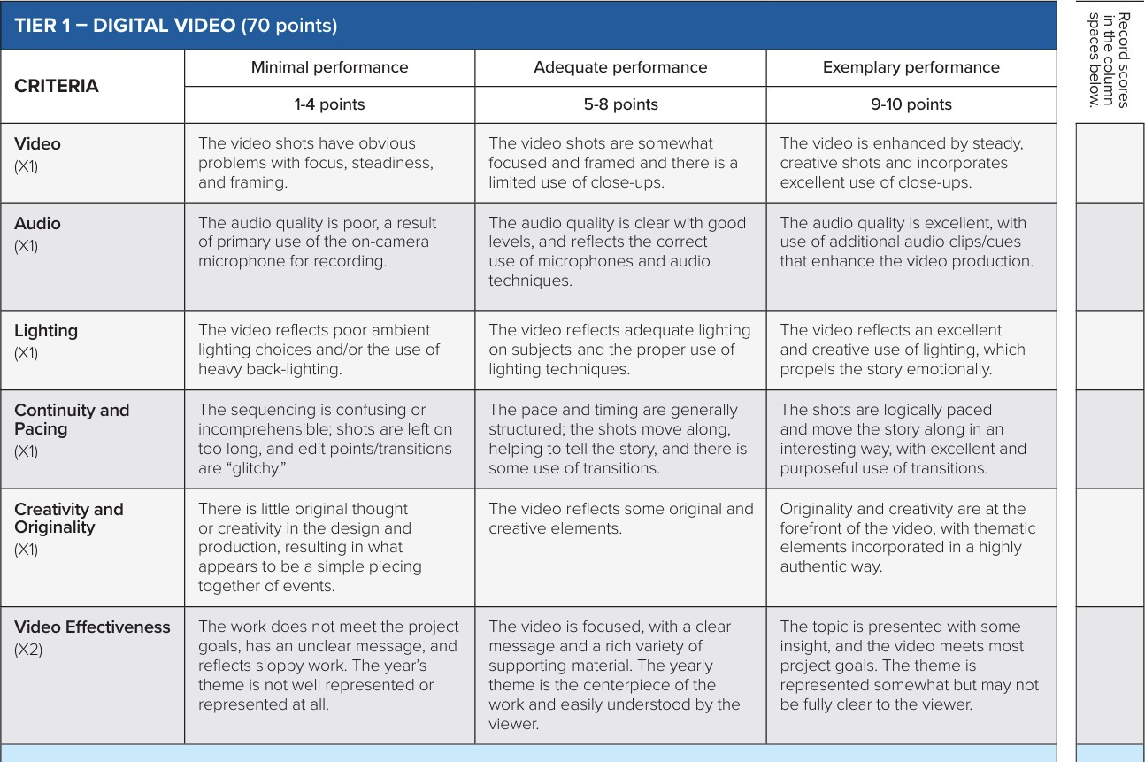
Evaluation of video
9
8
7
7
8
6
Total Score: 46

Slide 5
Storyboard
When storyboarding, we started by writing down everything we needed in the video. We focused on our ability to create it, the emotional impact and message of it, it’s relation to the 2024 national TSA theme, and the quality of the story itself in how it was somewhat realistic, made sense, had purpose, was professional, etc. As a team, we then gathered different ideas, landing on some such as the person ‘hearing’ a calling as if he was ‘tuning in to technology’ as per the theme, and the calling being his father’s unfinished present to him. Finally, we edited everything and turned it into a final draft, and began gathering props, writing out a specific scene-sheet, recording, and editing.
Image one: Character in a cabin working on a project on a messy table filled with different tools and papers, and candle visible on the side.
Image two: Character with his hands around his ears and depicted sound waves.
Image three: Character putting on a coat outside in front of his dad’s tombstone.
Image four: Character traveling through the forest, looking for the sound’s source. Image five: Character in front of his dad’s old workshop.
Image six: Character crying while looking at a photo, the gadget visible on the side. Image seven: Character completing the project using a wrench to tighten screws.
Image eight: A screw in the air as it is being thrown by the character.
Image nine: The character kneeling, smiling, and putting down the gadget in front of his dad’s tombstone.

Slide 6

Drawn Storyboard

Slide 7
Script/Scene Sheet
ACT ONE SCENE ONE
(ANNA is a high school student working her English essay until she hears a high pitch sound)
(ANNA is in her bedroom writing her essay on her computer until she hears a high pitch sound that snaps her out of her focus as she tries to focus back the high pitch sound comes back again.
As she tries to get back into focus, this sound reminds her of something, she decides to follow it)
(She grabs a coat and puts shoes on as she walks out the door)
ACT ONE SCENE TWO
(ANNA walking through the
woods)
(As ANNA approaches the woods the sound gets louder and louder. Then she stops in front of an old garage where the sound seems to stop)
(As she seems confused, she isn’t as scared, as this was her dad’s old garage. She hasn’t opened it ever since her dad passed away” ANNA: “sigh” [enters in passcode for the garage to open]
(The garage rumbles as it opens like a sign of relief)

Slide 8
Script/Scene Sheet
ACT TWO SCENE THREE
(ANNA in the garage)
[ANNA walks around the garage thinking of the memories with her dad when she used to sit on the side while her dad worked]
(As she takes a closer look at the table beneath the papers there seems to be something familiar. His OLD CAMERA. As she quickly reveal the camera and took a closer look at it she confirmed her guess)
ACT TWO SCENE FOUR
(ANNA fixes the camera)
[ANNA fixing the camera in a montage (As she thinks of her dad guiding her through it)]
ACT TWO SCENE FIVE
(ANNA puts the fixed camera in
front of her dad’s grave)
[ANNA putting the camera in front of his grave]
ANNA
“Thank you, Dad. The camera... the one you used to take all those memories of me. I’ve fixed it. Just like you always wanted me to. I’ll keep these moments with me, always.” *voiceover*

Slide 9
Hardware and Software Used
Hardware: School-issued Dell Latitude Laptop, iPhone 16 Pro Max, props such as
a drill, camera, wooden grave, table, etc.
Software: CapCut, Blender, Adobe After Effects, PowerPoint

Slide 10
References and Sources
Digital Video Production
"10 Video Editing Techniques to Make a Great Video in 2024." Shoots.video, 16 Dec. 2024,
https://www.shoots.video/post/10-video-editing-techniques-to-make-a-great-video-in-2024/.
"Digital Cinematography: Techniques & Explained." Vaia, 5 Nov. 2024, https://www.vaia.com/en- us/explanations/media-studies/filmmaking/digital-cinematography/.
Lighting in Video Production
"Film Lighting — The Ultimate Guide." StudioBinder, https://www.studiobinder.com/blog/film-lighting/.
"Three-Point Portraiture Lighting and Beyond." B&H Explora, https://www.bhphotovideo.com/explora/photography/tips-and-solutions/three-point-portraiture-lighting- and-beyond.
Sound & Audio Design
"Sound Design for Visual Media." Sound On Sound, https://www.soundonsound.com/techniques/sound-
design-visual-media.
Creativity & Effectiveness in Video Production
"The First 3 Videos Your Small Business Should Make." Wistia, https://wistia.com/learn/marketing/videos-for-small-business.
"The Art of Video Storytelling and Why It Matters for Your Marketing." Vimeo, https://vimeo.com/blog/post/video-storytelling/.

Slide 11
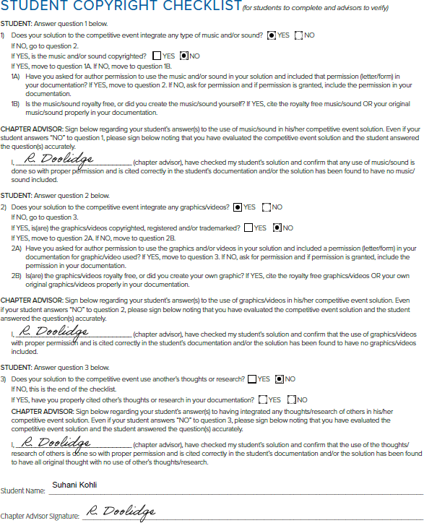

Slide 12
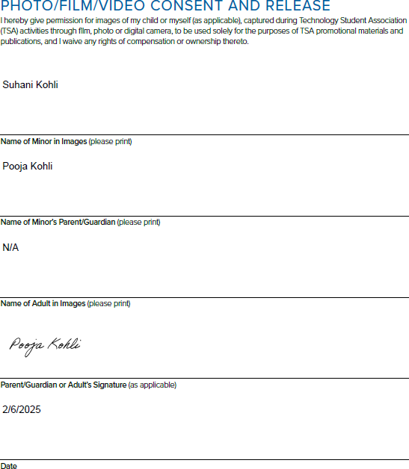

Slide 13
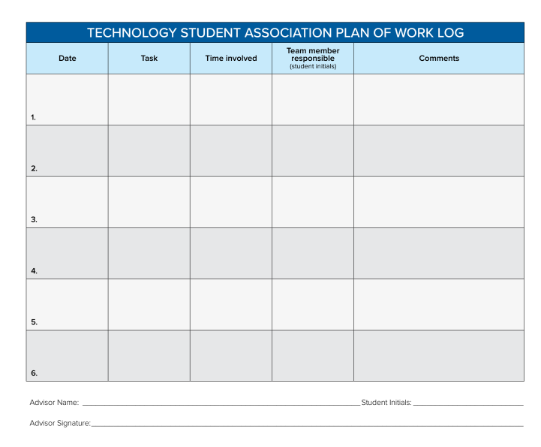


Info
Planning out
ideas
1 hour
SG, SK, AP
We planned out a few ideas for the video.
12/24
12/30
Planning out the video
SG, LC, AP
We planned what would happen in the video
1.5 hours
1/05
Writing references and gathering props
SG, LC, AP
We wrote a few references for the project while gathering props we would eventually use
2 hours
1/20
Scriptwriting
SG, LC
We wrote the entire script for the video
2 hours
1/31
Filming
3 hours
SG, AP, LC, AM
We filmed the video
2/04
Editing and Animation
1.5 hours
SG, LC, DJ
We animated and edited the video for use
Robert T Doolidge
AP, AC, SG, SK, DJ

